Slide 1
AWS

Slide 2
Whats’s AWS
AWS (Amazon Web Service) is a cloud provider
They provide you with server and service that you can use on demand and scale easily
AWS has revolutionized IT over time
AWS powers some of the biggest websites in the world
Amazon.com
Netflix.com

Slide 3
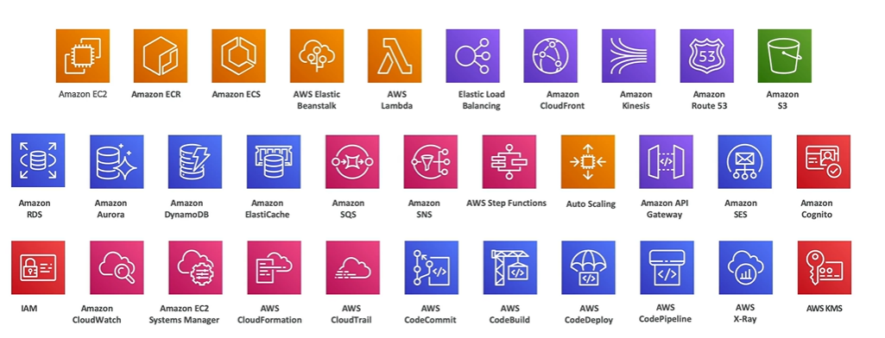
Road Map of AWS services

Slide 4
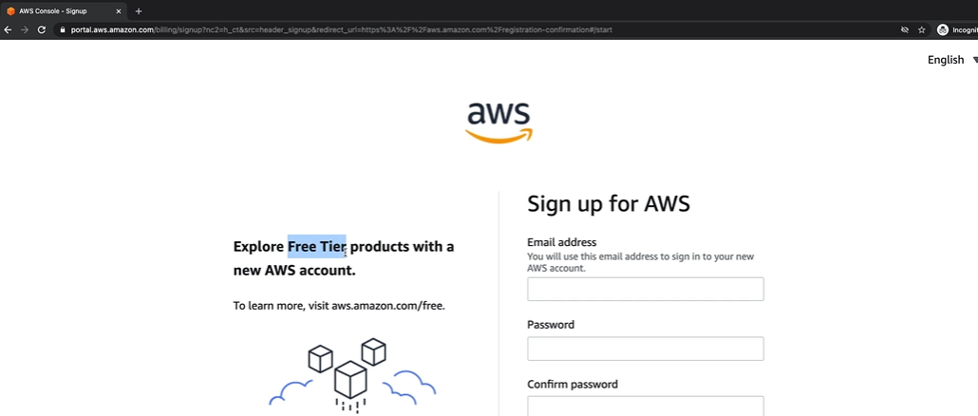
Create an account

Slide 5
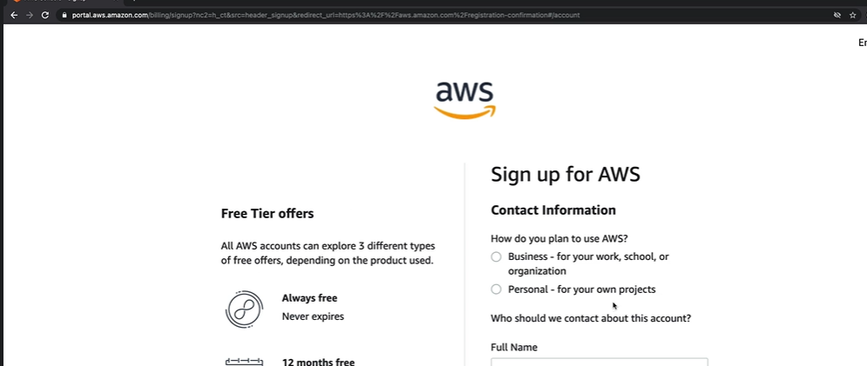
Detail Form

Slide 6
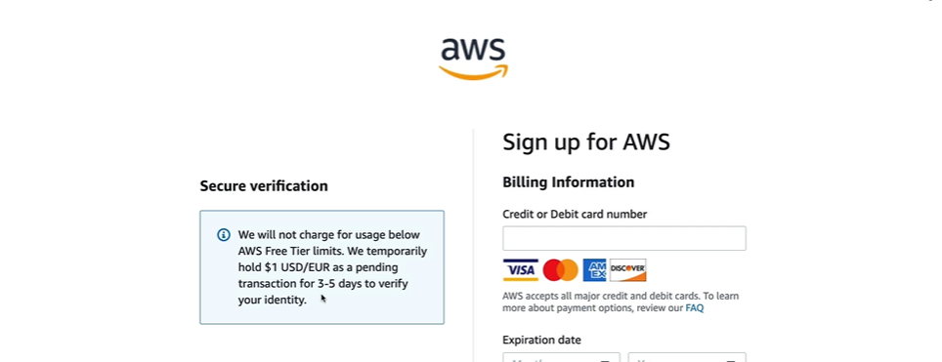
Sign up : Payment screen

Slide 7
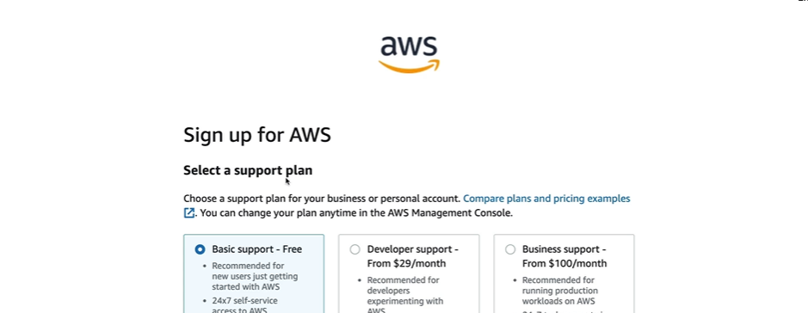
Plan

Slide 8
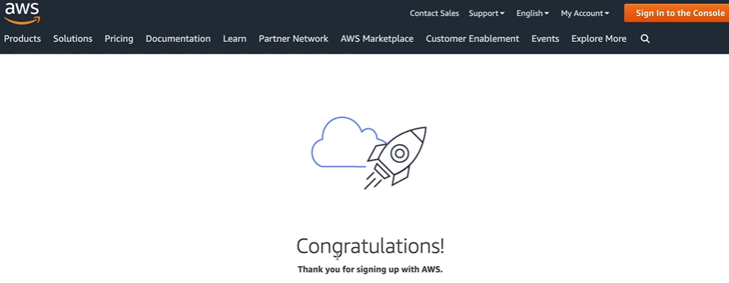
Account created

Slide 9
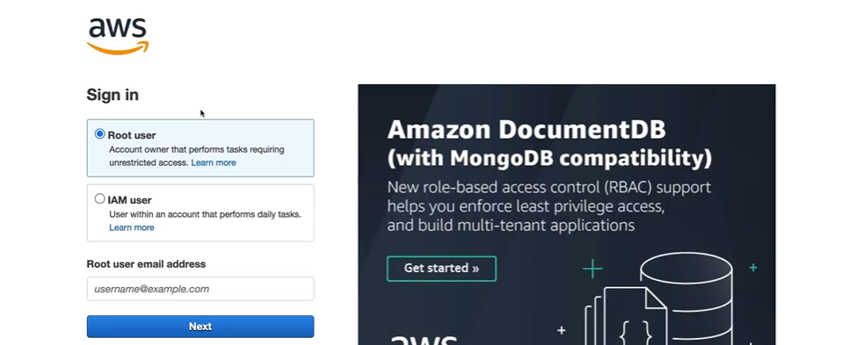
User selection

Slide 10
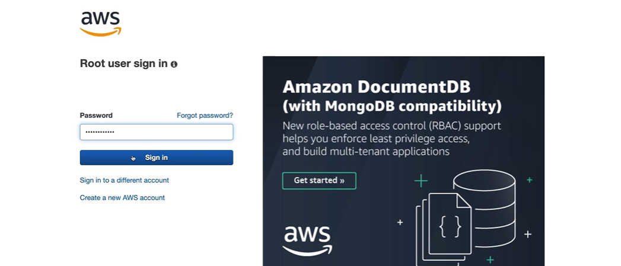
User password

Slide 11
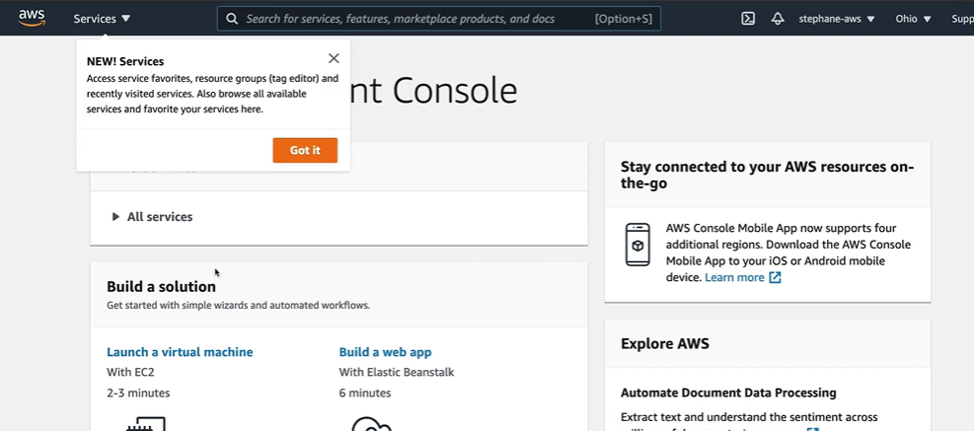
AWS console screen

Slide 12
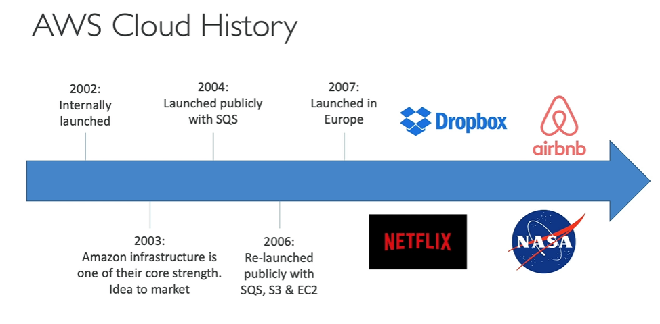
AWS cloud history

Slide 13
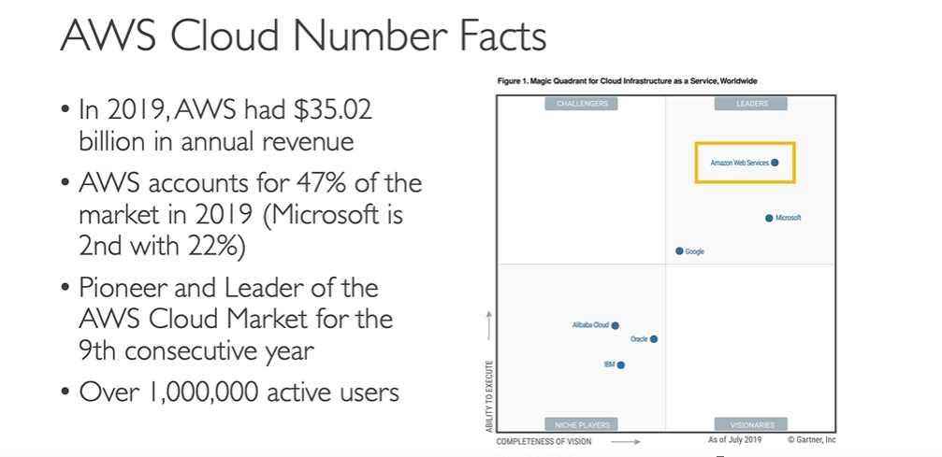
Now AWS is global.

Slide 14
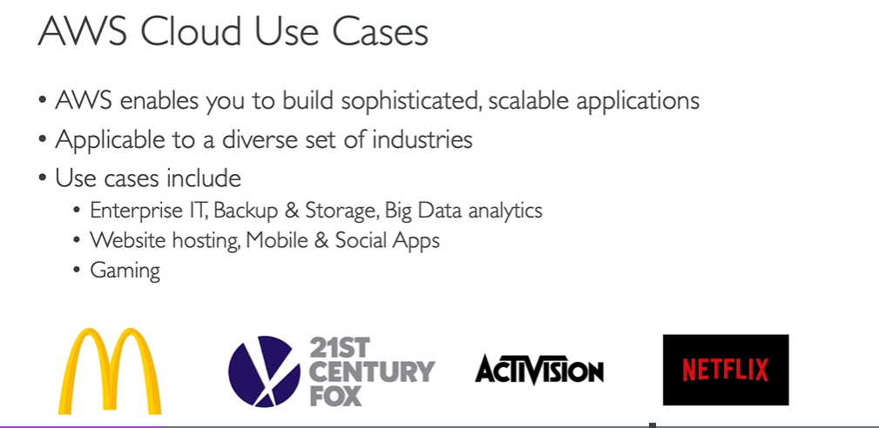
AWS cloud use case

Slide 15
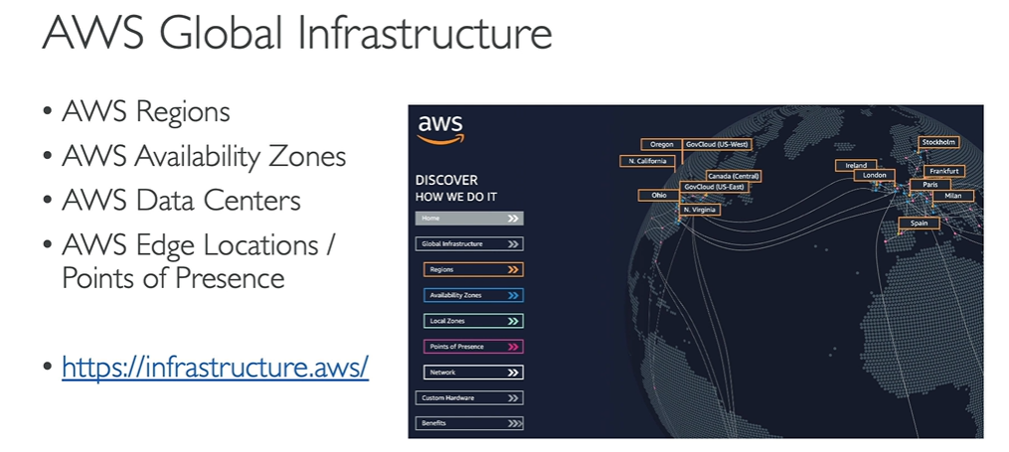
AWS Global Infrastructure

Slide 16
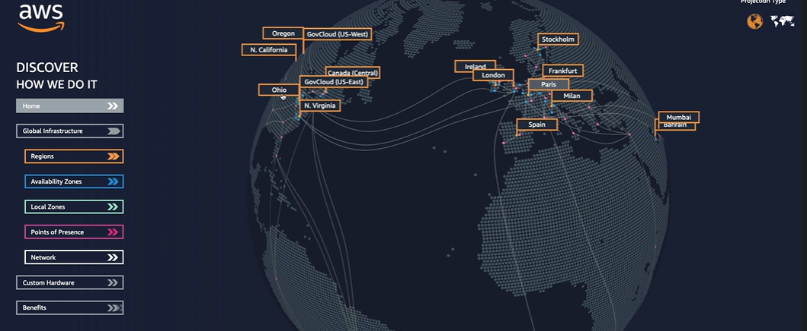
Global Infrastructure

Slide 17
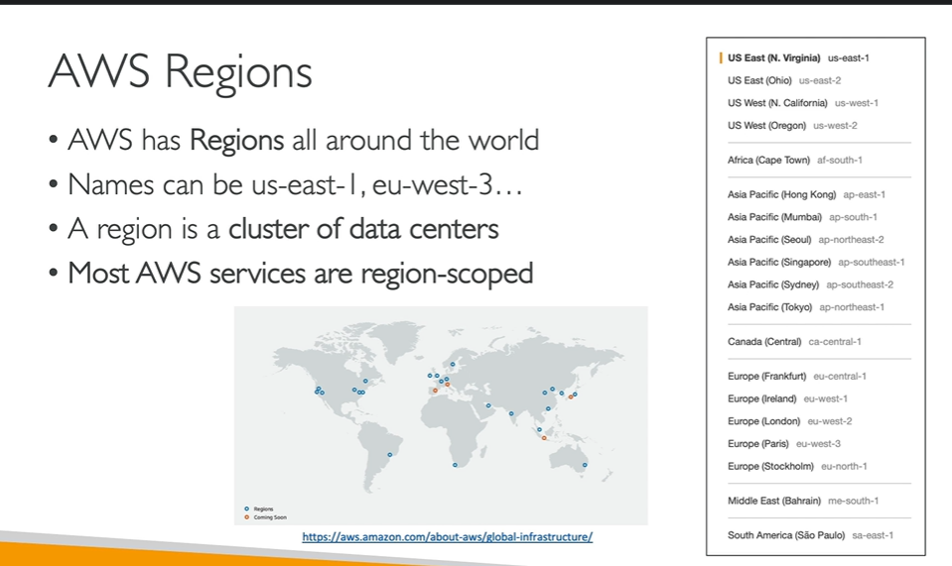
AWS Regions

Slide 18
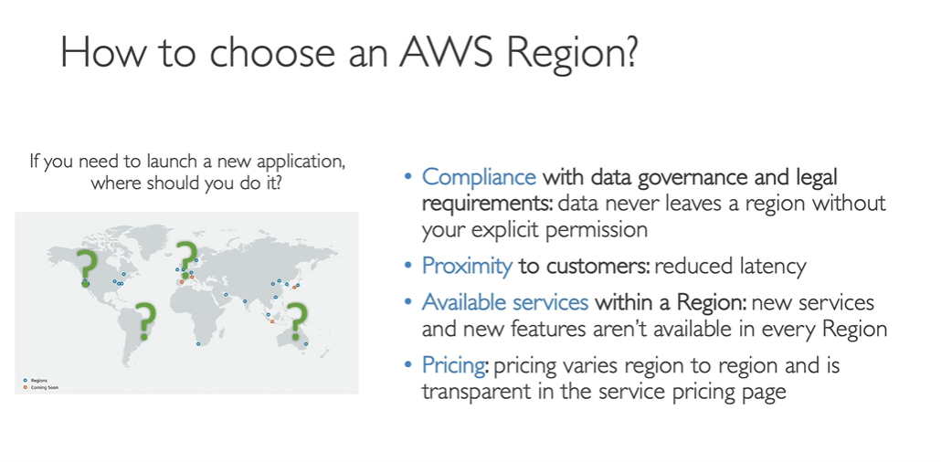
Aws Region selection

Slide 19
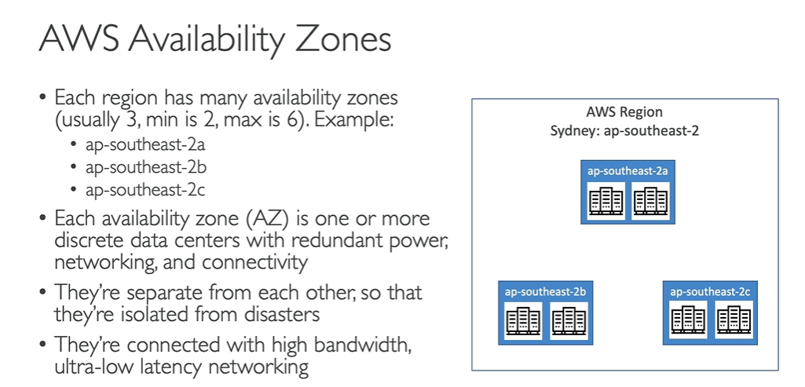
AWS Availability Zones

Slide 20
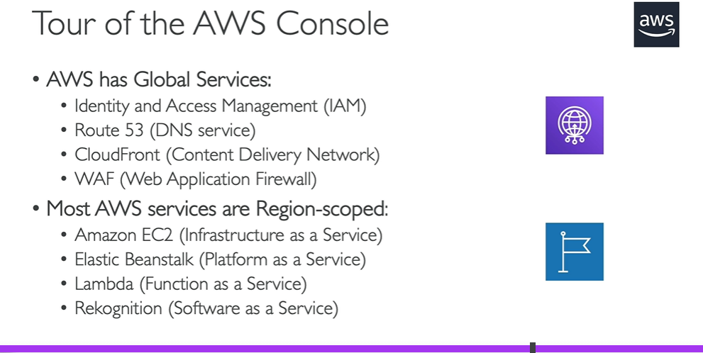
Tour of AWS Console

Slide 21
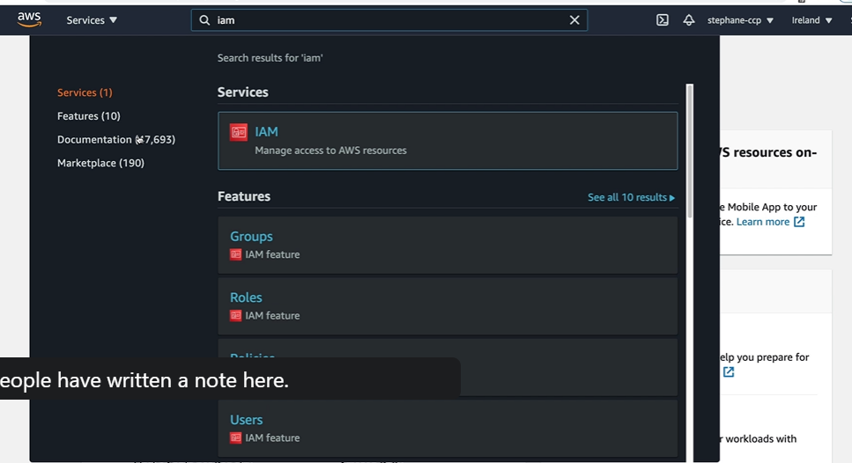
IAM search

Slide 22
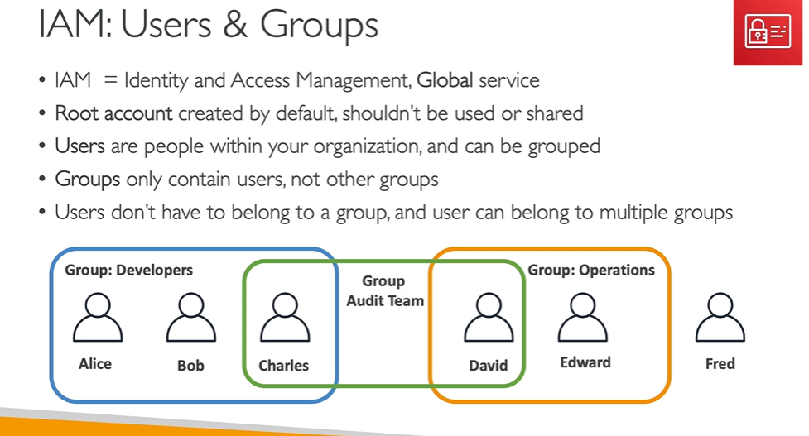
IAM

Slide 23
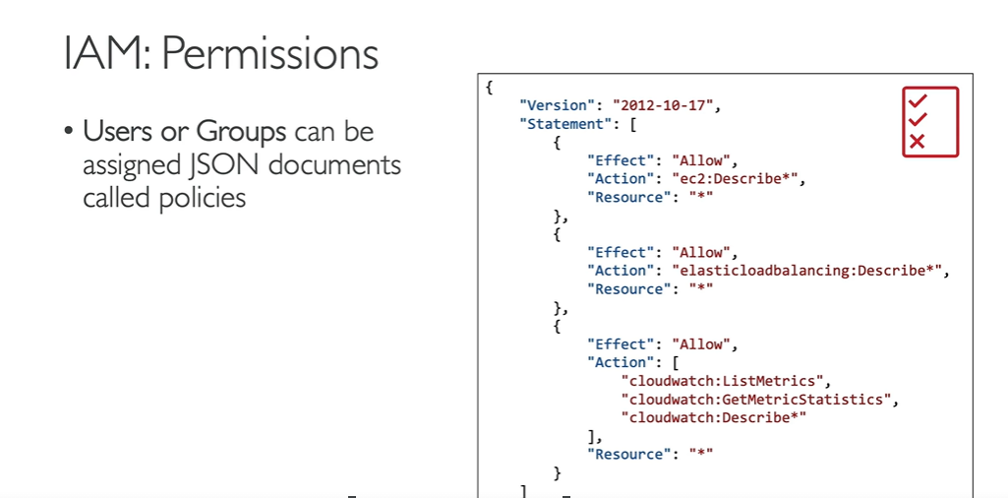
IAM Policy

Slide 24
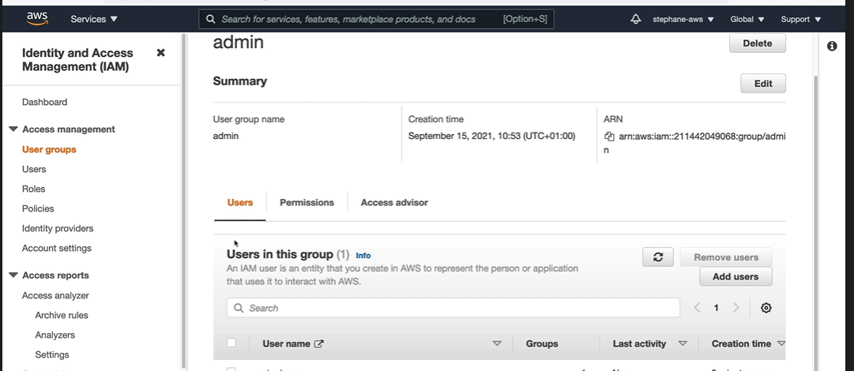
IAM User

Slide 25
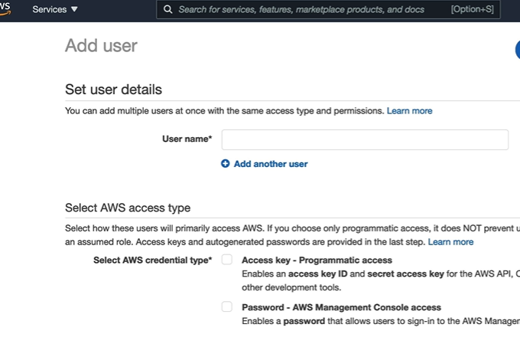
Add user to a group

Slide 26
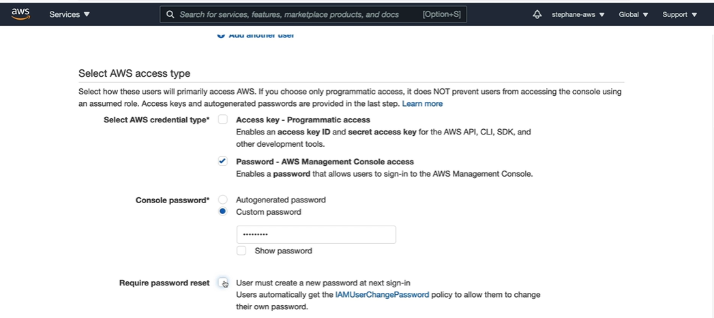
User Details

Slide 27
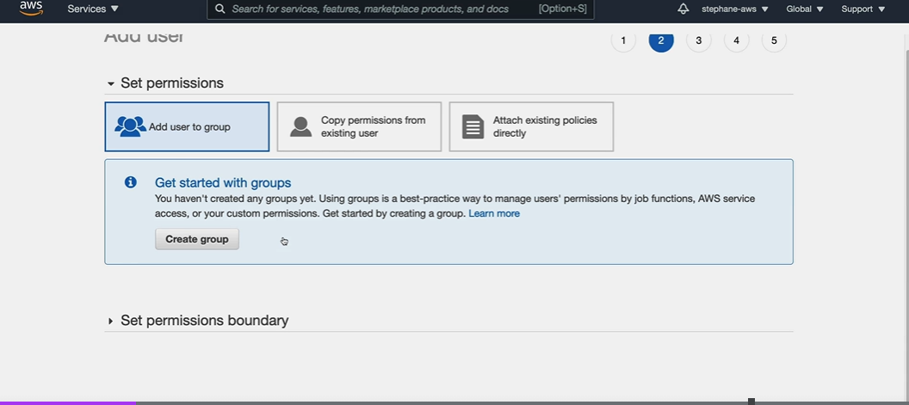
Add user to group

Slide 28
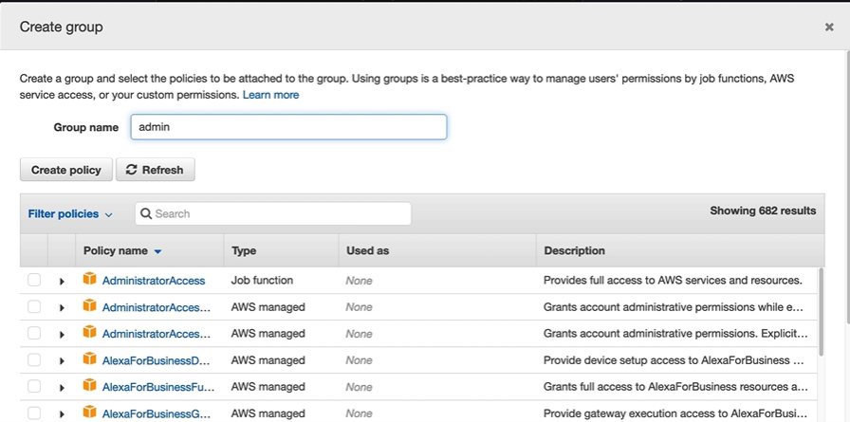
Select Policy in a Group

Slide 29
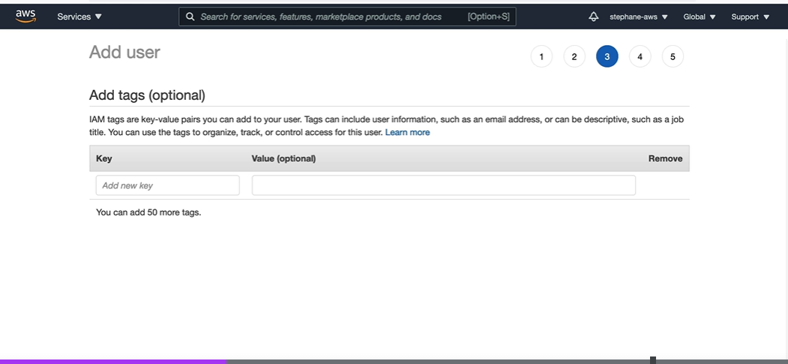
Add Tags in a Group

Slide 30
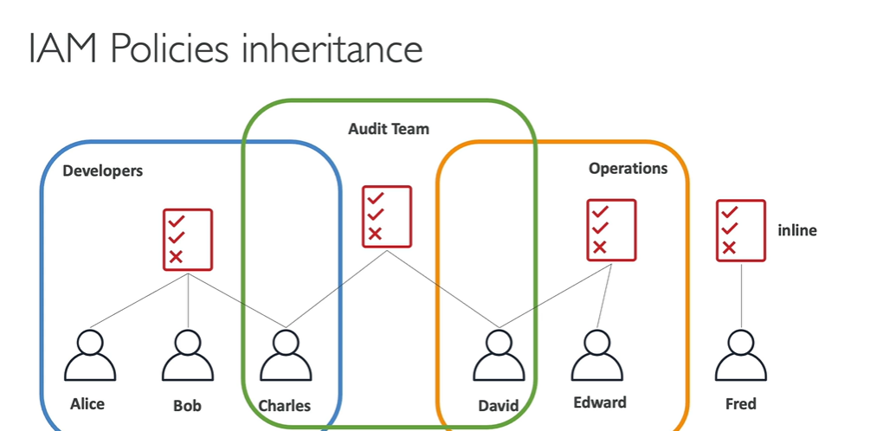
IAM Policies

Slide 31
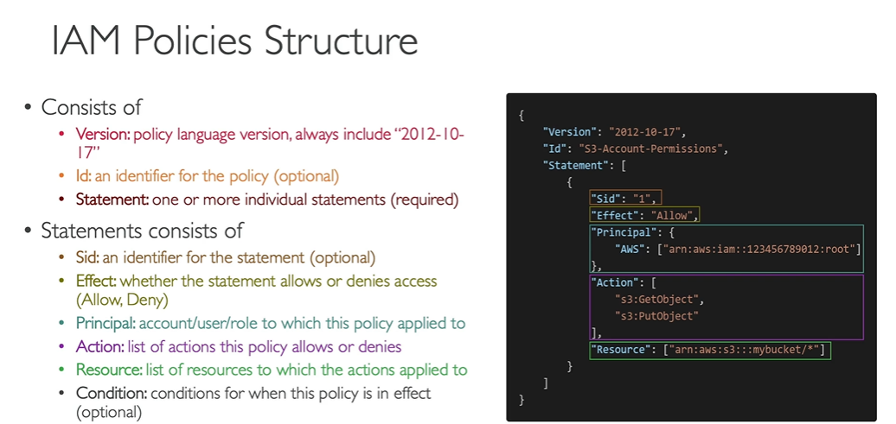
IAM Policies Structures

Slide 32
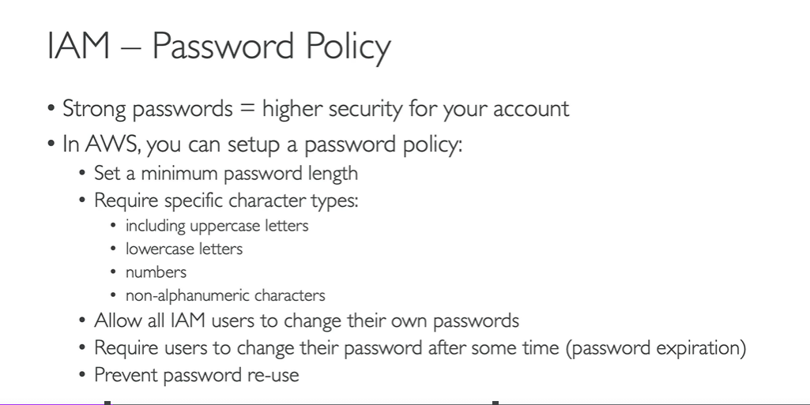
IAM – Password Policy

Slide 33
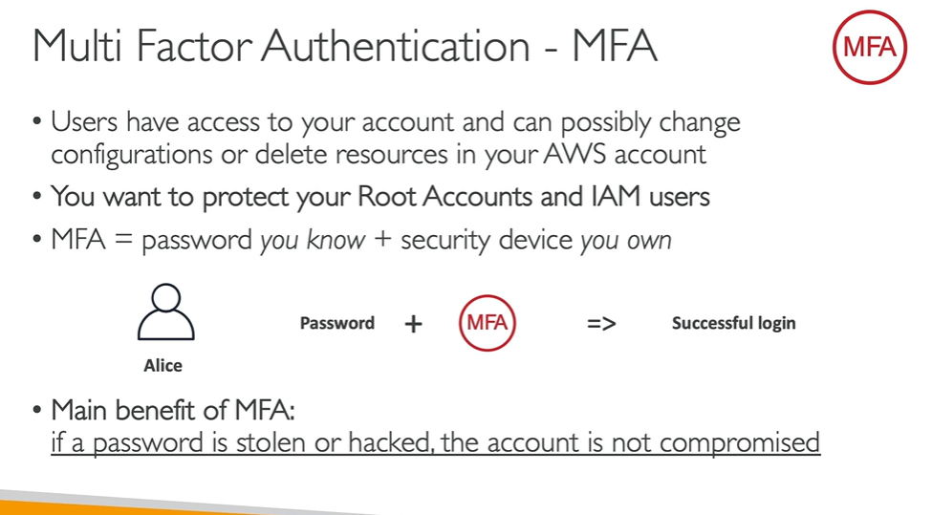
MFA

Slide 34
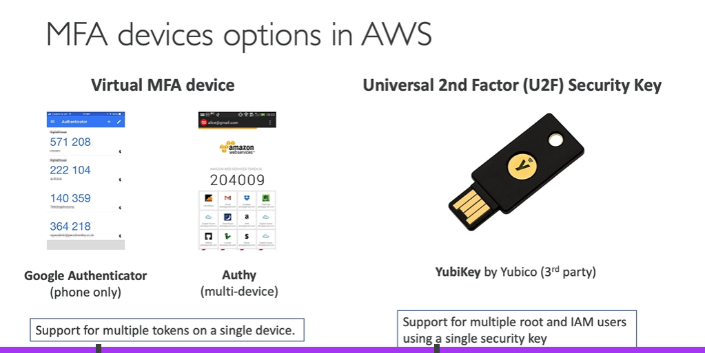
MFA Devices

Slide 35
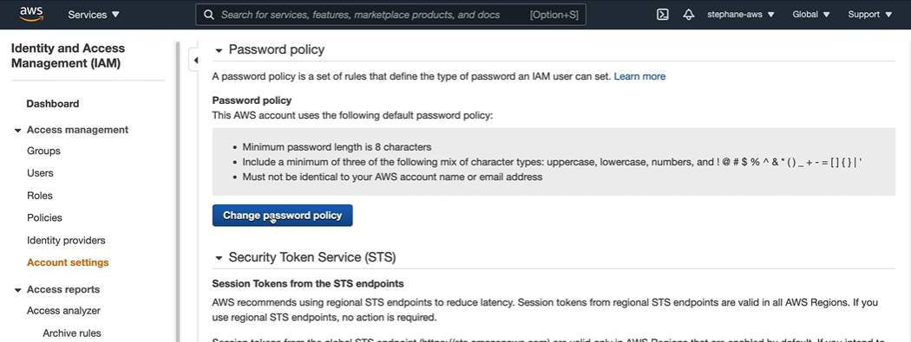
Password Policy creation button

Slide 36
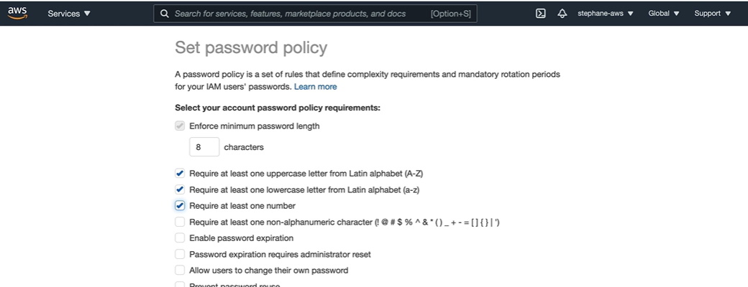
Set Password policy

Slide 37
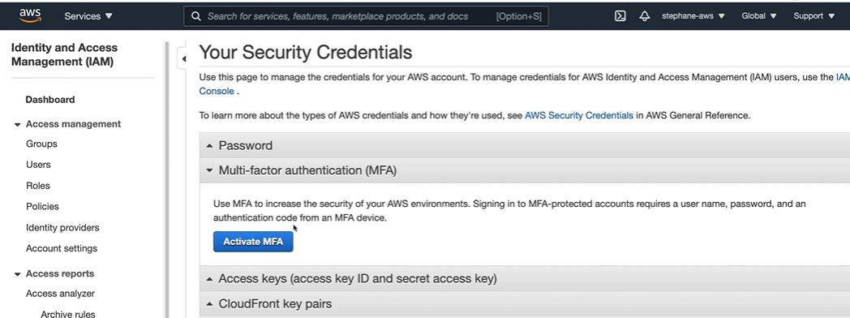
Activate MFA

Slide 38
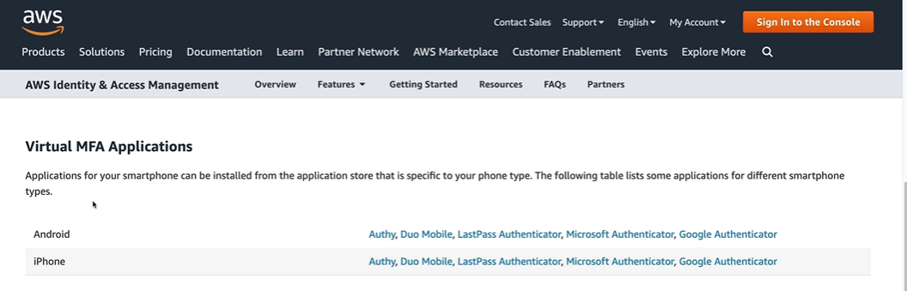
MFA Applications

Slide 39
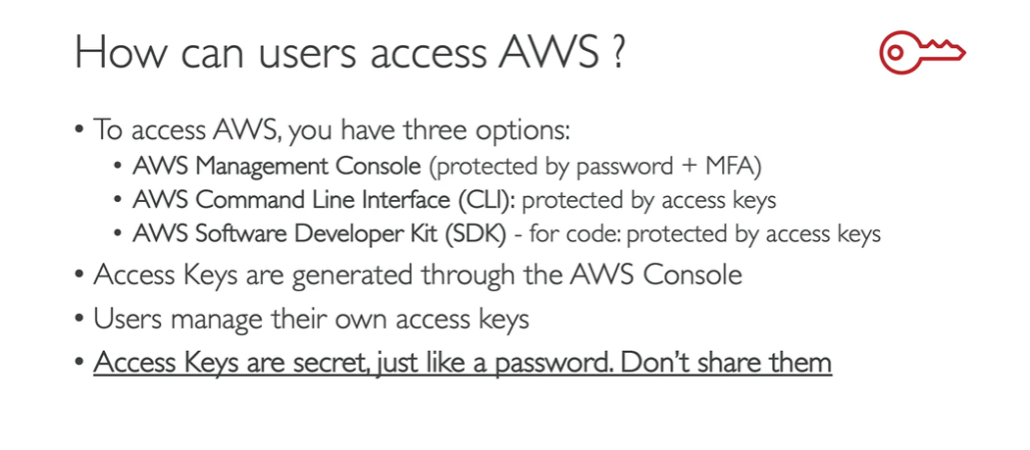
How can users access AWS

Slide 40
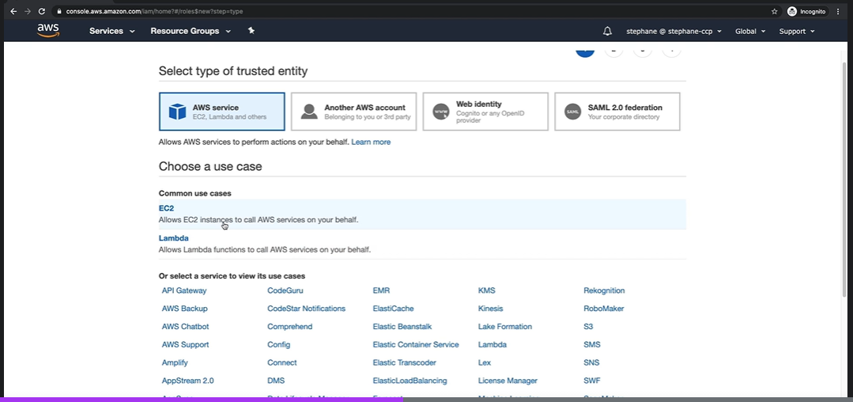
Role Selection

Slide 41
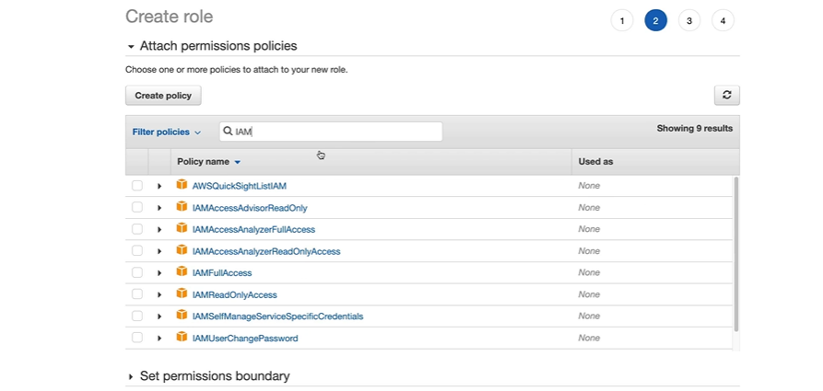
Role Permission

Slide 42
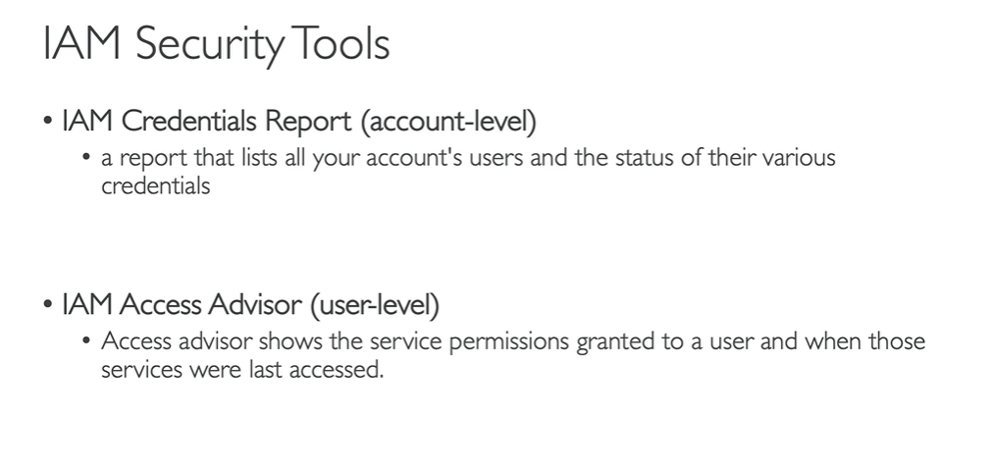
IAM Security

Slide 43
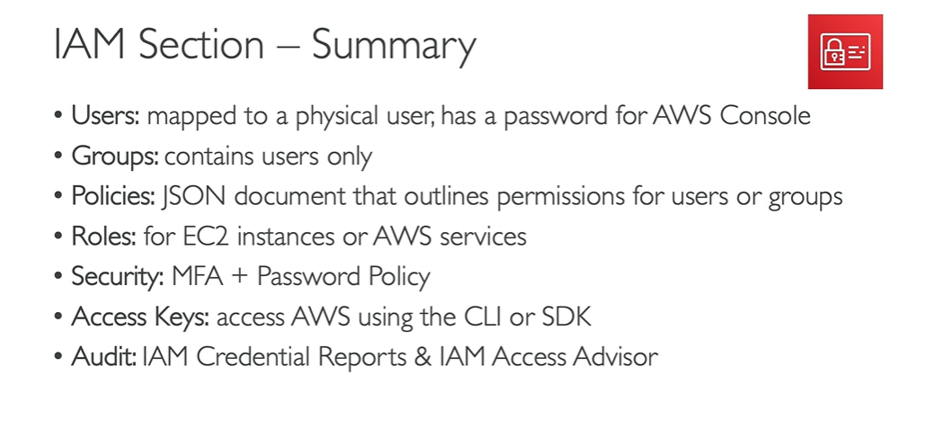
IAM Summary

